Slide 1

CVR COLLEGE OF ENGINEERING
(A UGC Autonomous Institution, NAAC ‘A’ Grade)
Vastunagar, Mangalpalli(V), Ibrahimpatnam(M), Rangareddy(D), Telangana 501510
AI-Powered Recipe Generation
This presentation will explore the exciting world of AI-powered recipe generation. We'll discuss the technology behind it, how it works, and the potential impact on the food industry.
Guide:
Dr. C.V.S Satyamurty
Associate professor
Batch-11:
22B81A1284- D. Laxmi Prasanna
22B81A1293- Yasa Nikitha Reddy
22B81A12B7- T. Sri Varsha

Slide 2
Abstract
The AI Automated Recipe Generator is a smart system that suggests recipes based on available ingredients. It leverages AI to provide personalized and dynamic meal recommendations. The system enhances user experience by simplifying meal planning with minimal effort.
The system allows users to select ingredients and generates recipes accordingly. It includes a user-friendly interface with search and filtering options. Users can also provide feedback and ratings for recipe improvements.
We are integrating AI-based meal planning to suggest recipes based on dietary preferences. A voice-enabled assistant will allow hands-free ingredient selection. Additionally, we are improving the recipe recommendation engine using ML models.
We use Natural Language Processing (NLP) for ingredient recognition and Collaborative Filtering for personalized recommendations. Machine Learning models (e.g., Random Forest, Neural Networks) improve recipe suggestions. Optimized database queries enhance search efficiency.

Slide 3
Introduction to AI Recipe Generation
Revolutionizing the Kitchen
AI-powered recipe generators are transforming how we cook by offering personalized, dynamic meal solutions based on user preferences and available ingredients.
They simplify meal planning, encourage creativity in the kitchen, and save time by eliminating the need for manual recipe searches.
From beginners to expert chefs, this technology inspires confidence and makes cooking more efficient and enjoyable.
Key Advantages
AI recipe generators reduce food waste by utilizing leftover ingredients, cater to diverse dietary needs, and save time with instant recipe suggestions.
They ensure meals are both nutritious and delicious, while their ability to learn from user feedback makes them increasingly effective over time.
These tools are a game-changer for modern cooking, combining convenience, sustainability, and personalization.

Slide 4
Existing Recipe Generation Approaches
Existing recipe generation approaches include rule-based systems, machine learning models, and natural language processing techniques.
These approaches have limitations, including the difficulty of capturing the nuances of human creativity, the need for extensive datasets, and the challenge of ensuring recipe feasibility and safety.
AI-based recommendation systems personalize recipe suggestions by analyzing user preferences, dietary restrictions, and past behavior.
Collaborative filtering and content-based filtering techniques have been widely used in food recommendation engines.
Deep learning models (CNNs) are used for image-based ingredient recognition, improving automated recipe generation.
NLP techniques are applied to generate human-like cooking instructions from structured recipe data.

Slide 5
Problem Statement
Cooking can be a challenge for individuals who struggle with recipe selection, ingredient availability, or dietary restrictions. People often waste ingredients due to a lack of suitable recipes, while others find it difficult to plan meals that meet their nutritional needs.
Time-Consuming Recipe Search – Manually browsing through multiple sources to find a suitable recipe is inefficient and frustrating.
Ingredient Waste – Without AI-driven suggestions, people often fail to use available ingredients effectively, leading to unnecessary food wastage.
Lack of Personalization – Traditional recipe searches do not cater to individual preferences, dietary restrictions, or allergies, making it difficult to find appropriate meal options.
Difficulty in Meal Planning – Planning balanced, nutritious meals requires effort and research, especially for those with specific dietary needs or busy schedules.
AI-powered solutions help overcome these challenges by streamlining recipe discovery, improving personalization, reducing waste, and enhancing the overall cooking experience.

Slide 6
Objectives of the AI-Automated Recipe Generator
AI-Driven Recipe Discovery
Smart Ingredient Utilization
Personalized Meal Recommendations
Support for Dietary Restrictions and Nutrition
Automated Meal Planning
User-Friendly Smart Interface
Enhanced Cooking Experience

Slide 7
Techniques for AI Recipe Generators
Content-Based Filtering: Suggests recipes based on user preferences like ingredients, cuisine, or calorie count. Focuses on similar recipe features.
Collaborative Filtering: Recommends recipes liked by users with similar tastes. Relies on collective behavior.
Hybrid Systems: Combines content-based and collaborative filtering for better accuracy and diversity.
Ingredient-Based Matching: Suggests recipes based on the ingredients users have, reducing food waste.
Rule-Based Filtering: Filters recipes based on dietary restrictions, allergies, or calorie limits using predefined rules.
AI-Driven Personalization: Uses machine learning to predict preferences based on past interactions, continuously improving recommendations.

Slide 8
System Design: Classes, Interfaces, and Class Diagrams
The system is designed using object-oriented principles with well-defined classes and interfaces to ensure modularity and scalability.
Key classes include Recipe, Ingredient, Instruction, User, Feedback, RecipeGenerator (AI Model), and ImageRecognition, each managing specific functionalities.
Interfaces define core methods for recipe generation, data storage, feedback processing, and user interactions, ensuring flexibility and seamless integration.
The class diagram consists of multiple classes and their relationships. The key relationships include: User → Saves Recipes → Recipe User → Provides Feedback → Recipe Recipe → Contains → Ingredients AI Model → Generates → Recipe Image Recognition → Detects → Ingredients

Slide 9
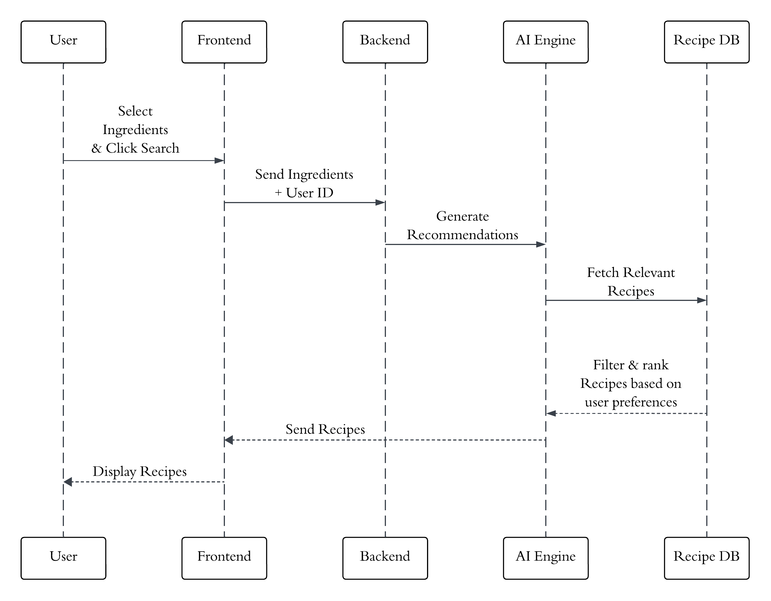

Slide 10
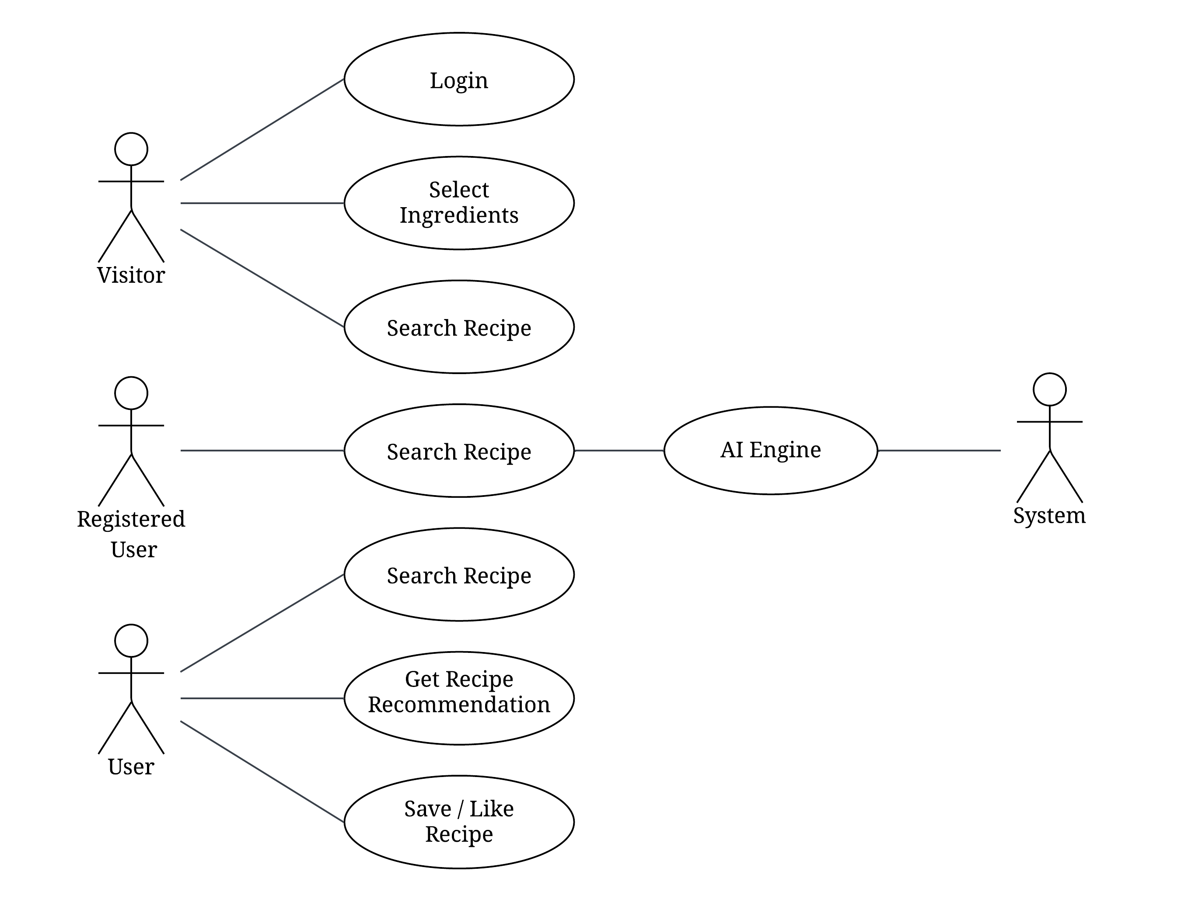

Slide 11
The database design follows a relational model, with key tables such as Users, Recipes, Ingredients, Instructions, Feedback, AI_Model, AI_Recipe_Suggestions, and ImageRecognition.
The Users table stores user details, login credentials, and preferences.
The Recipes table manages recipe information, including name, cuisine, cooking time, and difficulty level.
The Ingredients table stores ingredient names, categories, and nutritional information.
The Recipe_Ingredients table establishes a many-to-many relationship between recipes and ingredients, specifying the required quantity for each.
The Instructions table provides step-by-step guidance for preparing a recipe.
The Feedback table collects user ratings and comments to enhance recipe quality.
The AI_Model table stores details about the trained AI model, including accuracy, version, and dataset information.
The AI_Recipe_Suggestions table keeps track of AI-generated personalized recipe recommendations for users.
The ImageRecognition table records detected ingredients from user-uploaded images to improve ingredient-based recipe suggestions.

Slide 12
User Interface (UI) Design
The UI design prioritizes user-friendliness and an engaging experience.
Users can easily search for recipes, filter by dietary restrictions, and customize recipes to their preferences.
The provides step-by-step instructions, visual cues, and helpful tips for cooking success.
A smart ingredient selection feature allows users to input available ingredients, and the system suggests relevant recipes.
A personalized dashboard enables users to save favorite recipes, track cooking history, and set meal plans.
Real-time nutritional analysis provides calorie and macronutrient breakdowns for each recipe.
A feedback and review section allows users to rate recipes, share modifications, and interact with the cooking community.
A shopping list generator allows users to add missing ingredients from a recipe directly to their list.

Slide 13
Software Requirements Specification
Programming Languages:
Frontend: HTML5, CSS3, JavaScript (React.js or Vue.js).
Backend: Python (Flask/FastAPI) or Node.js.
Frameworks and Libraries:
Frontend: Tailwind CSS, Material-UI, or Bootstrap for responsive design.
Backend: Flask/FastAPI for APIs, TensorFlow/PyTorch for AI models.
Tools and IDEs:
Visual Studio Code, PyCharm, or IntelliJ IDEA.
Git for version control.
Database:
Relational: PostgreSQL or MySQL.
Non-relational: MongoDB for unstructured data.
AI and ML Libraries:
TensorFlow, PyTorch, or Scikit-learn for model development.
Natural Language Toolkit (NLTK) or Hugging Face Transformers for NLP.
API Integration:
Spoonacular or Edamam APIs for recipe datasets and nutritional information.

Slide 14
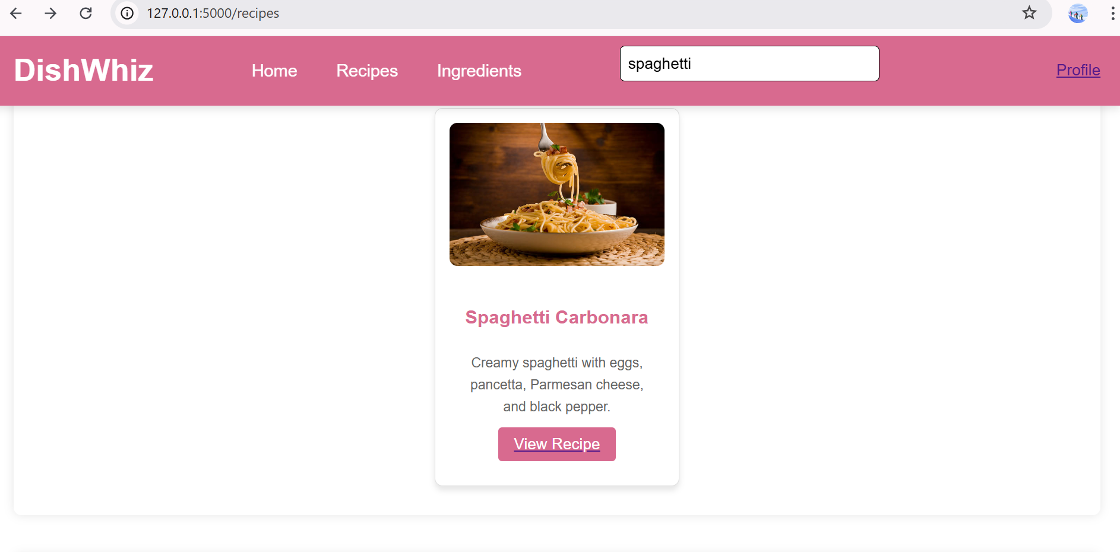

Slide 15
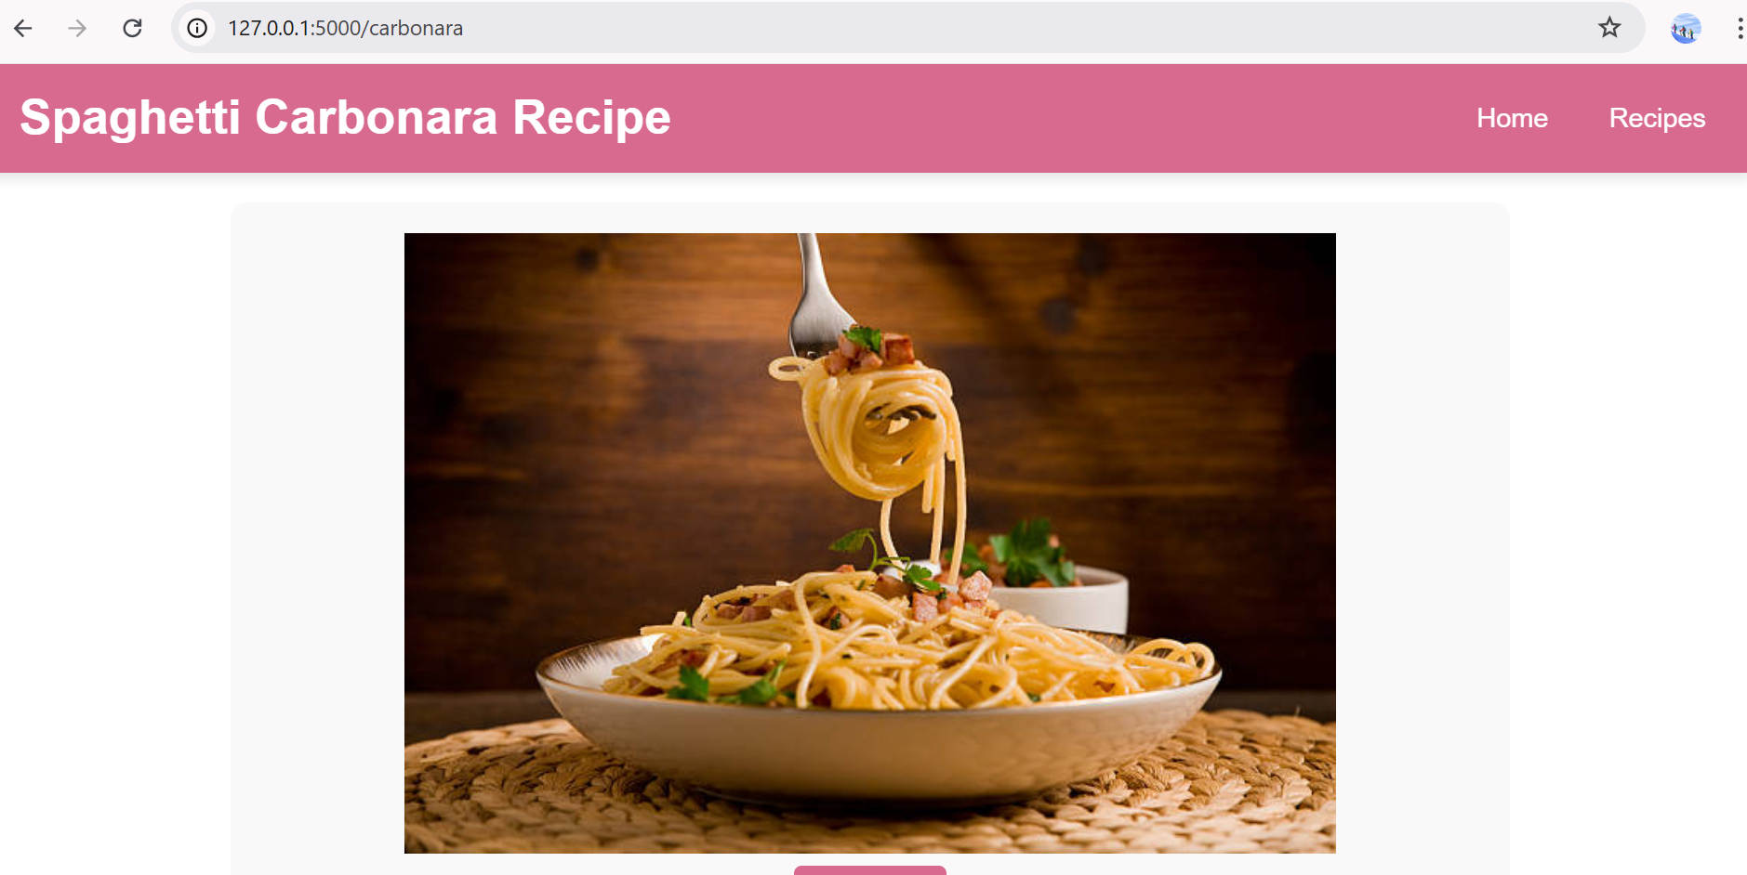

Slide 16
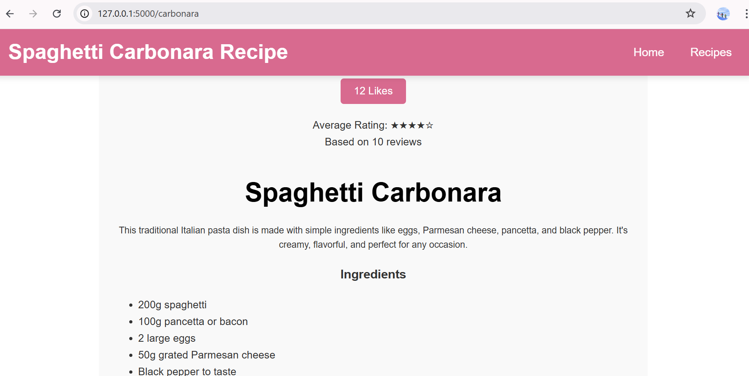

Slide 17
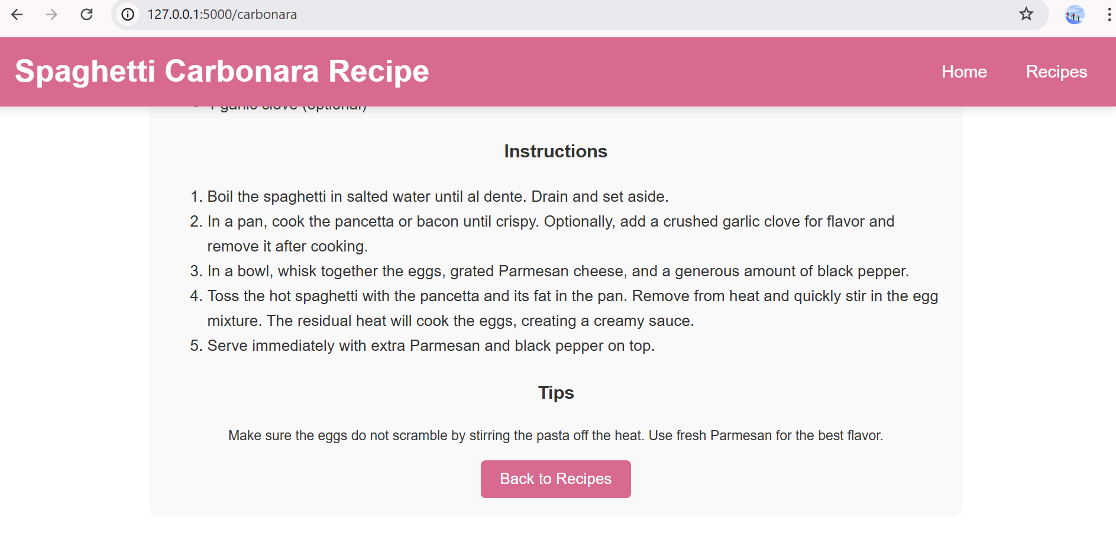

Slide 18
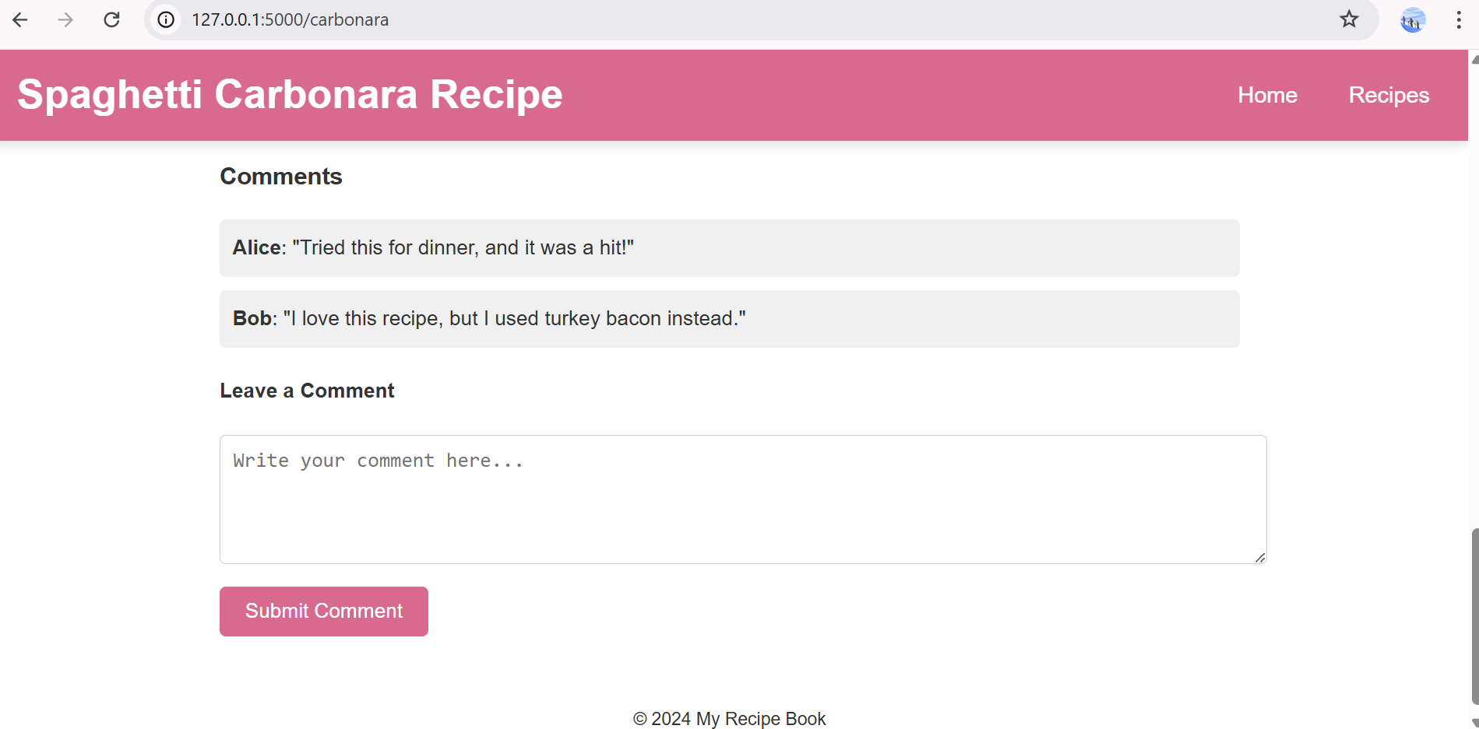

Slide 19
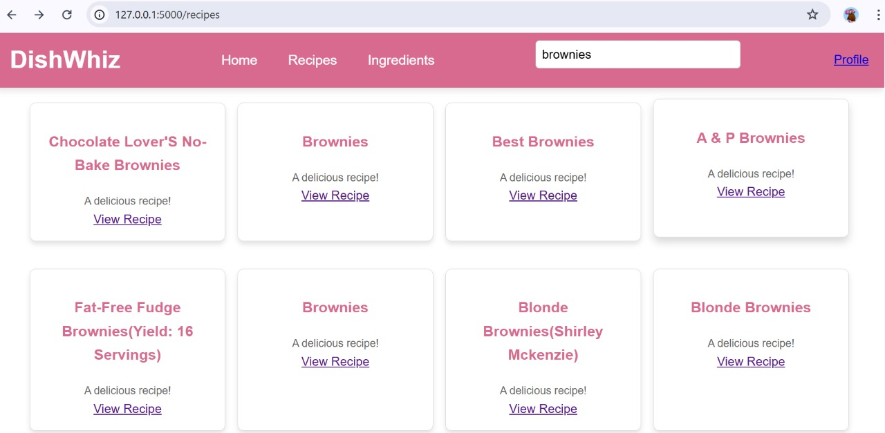

Slide 20
Front End:
Technologies:
HTML, CSS, JavaScript – Core web technologies for structuring, styling, and interactivity.
React.js or Vue.js – For building a dynamic and responsive user interface.
Tailwind CSS or Bootstrap – For styling and ensuring a mobile-friendly UI.
Key Features:
User-Friendly Interface – A clean, intuitive design allowing users to easily navigate through recipe recommendations, ingredient searches, and meal planning features.
Search and Filter Options – Users can search for recipes based on ingredients, cuisine type, dietary preferences, cooking time, and difficulty level.
Ingredient Selection with Image-Based Input – Users can select ingredients through images instead of text, making the process more interactive and visually appealing.
Personalized Recipe Suggestions – AI-driven recommendations tailored to user preferences, past interactions, and dietary restrictions.

Slide 21
Step-by-Step Cooking Instructions – Detailed, interactive guides with images, timers, and video tutorials for easy cooking.
Nutritional Information Display – Each recipe includes calorie counts, macronutrient breakdowns, and other dietary information.
Ingredient Substitution Recommendations – If an ingredient is unavailable, the system suggests alternative options.
Dynamic Recipe Scaling – Users can adjust serving sizes, and the ingredient quantities automatically update.
User Reviews and Ratings – Users can leave feedback, rate recipes, and share cooking experiences.
Login and Profile Management – Users can create accounts to track their cooking history, preferences, and saved recipes.
Interactive Meal Planner – Allows users to plan weekly meals and generate shopping lists based on selected recipes.
Real-Time Feedback and Chat Support – Users can ask questions and get AI-generated cooking tips instantly.

Slide 22
Back End:
Technologies:
Node.js with Express.js – For handling API requests, user authentication, and server-side logic.
Django or Flask (Python Alternative) – If using Python for AI model integration.
Database & Storage : MongoDB – For storing user data, recipes, and feedback.
Key features:
User Authentication & Authorization – Secure login and sign-up system using JWT, OAuth, or Firebase Authentication.
Recipe Storage & Management – A structured database to store, retrieve, and manage user-created and AI-generated recipes.
AI-Powered Recipe Recommendation – Machine learning models analyze user preferences and suggest recipes based on dietary needs, ingredient availability, and past interactions.

Slide 23
Ingredient Recognition & Substitution – Computer vision and NLP models allow users to upload images of ingredients, detect them, and suggest alternatives if necessary.
Dynamic Meal Planning & Nutritional Analysis – AI calculates nutritional values and provides meal plans based on health goals, allergies, and preferences.
Real-Time Search & Filtering – Efficient algorithms to quickly filter recipes based on ingredients, cuisine, cooking time, and dietary restrictions.
User Feedback & Personalization – Backend stores user interactions, ratings, and comments to refine recommendations over time.
API Integrations – Connects with external recipe APIs (e.g., Spoonacular, Edamam) and food databases for enriched data.
Scalability & Performance Optimization – Load balancing, caching (Redis), and microservices ensure high performance and fast response times.
Secure Data Handling – Encryption and best security practices protect user data, including recipes, preferences, and personal information.

Slide 24
Conclusion
In summary, an AI automated recipe generator, a subset of machine learning applications, leverages big data to suggest recipes based on user preferences, ingredients, and dietary restrictions. Using techniques like collaborative filtering, content-based filtering, hybrid approaches, and natural language processing, these systems provide tailored and dynamic recipe suggestions.
In today's fast-paced world, AI recipe generators surpass traditional cookbooks and manual searches by offering personalized, efficient, and creative solutions for meal preparation. These tools enhance the cooking experience by promoting sustainability, reducing food waste, and meeting diverse dietary needs. For students and ML enthusiasts, building an AI recipe generator is a challenging yet rewarding project that bridges theoretical concepts with real-world applications, preparing them for industry demands in AI-driven innovation.

Slide 25
THANK YOU…..

